Slide 1
The Grand Challenge of Sustainable Development:
Laying the Vital Foundations for the 21st Century
Prof. Jeffrey D. Sachs
Special Advisor to
UN Secretary General Ban Ki-moon
High-Level Political Forum
July 8, 2014

Slide 2
Building Blocks of the Next 18 Months:
Sustainable Development Goals
Comprehensive Climate Agreement
The Means of Implementation
Data, Monitoring and Updating
Governance and Accountability

Slide 3
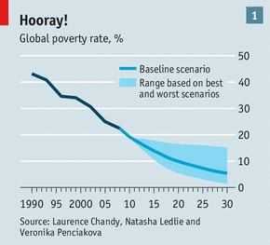

Slide 4
“PLANETARY BOUNDARIES”
Source: Rockström et al 2009a)

Slide 5
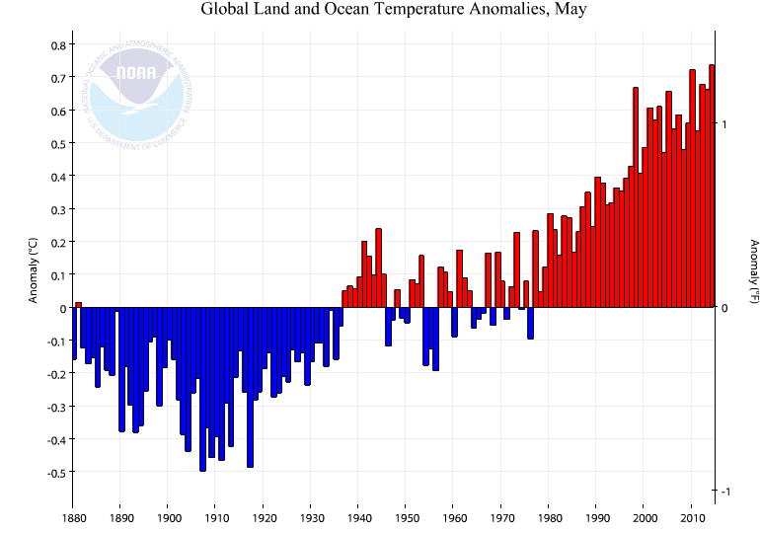
HOTTEST MAY IN RECORDED HISTORY (Anomalies relative to 1981-2010)

Slide 6
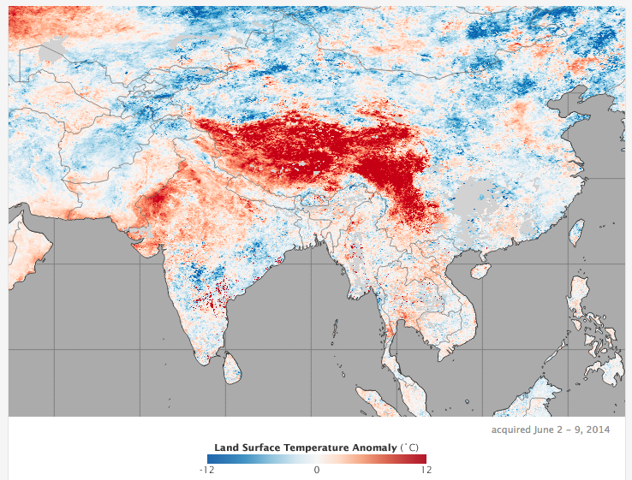

Slide 7
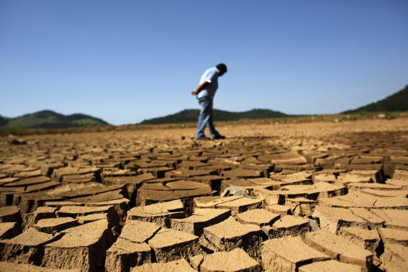
MEGA-DROUGHT IN SAO PAULO, BRAZIL FEBRUARY 2014

Slide 8
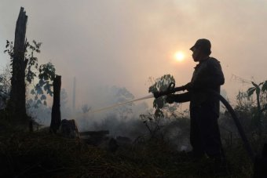
Drought and Forest Fires in Sumatra, March 2014

Slide 9
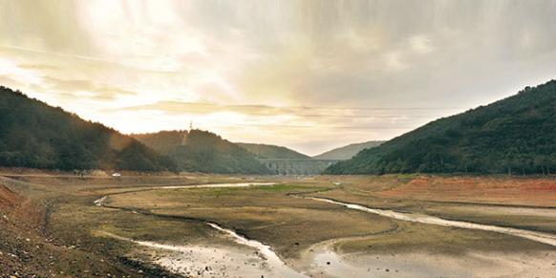
LOW WATER LEVELS IN ISTANBUL’S ALIBEYKöY RESERVOIR
FEBRUARY 2014

Slide 10
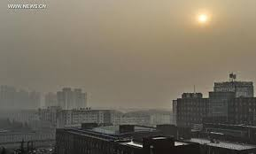
BEIJING ENVELOPED IN POLLUTION, JANUARY 2014

Slide 11
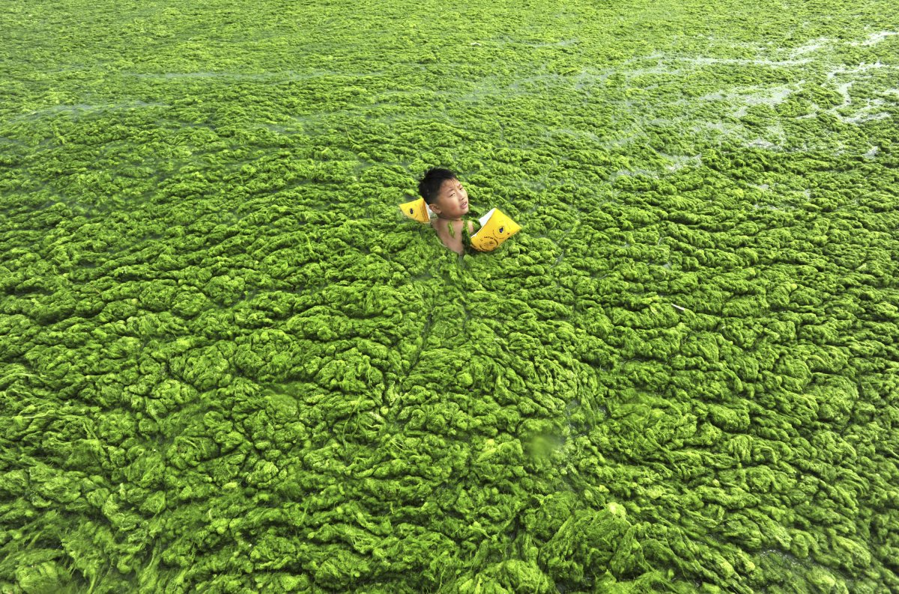
Algal Bloom, Qindao, Shandong Province, 2013

Slide 12
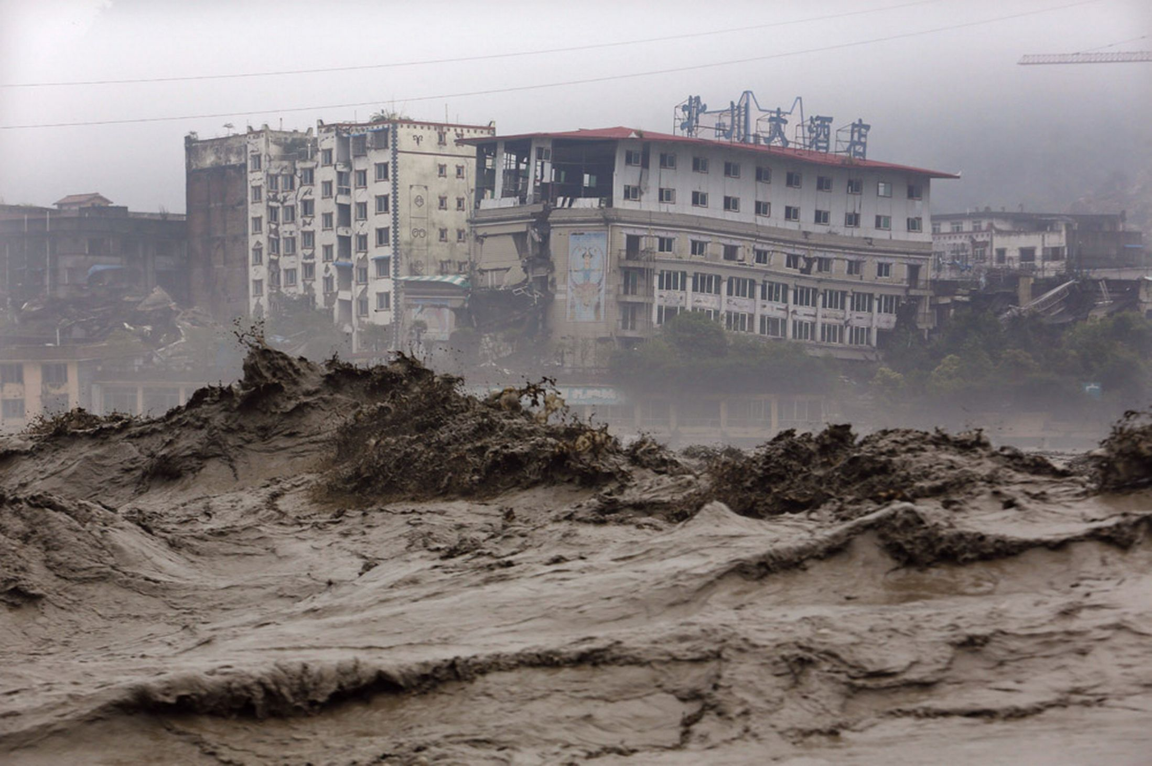
BEICHUAN, SICHUAN PROVINCE, JULY 2013

Slide 13
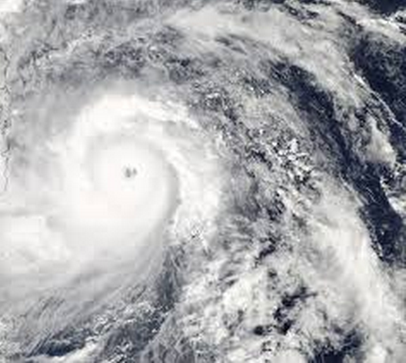
By some
measurements,
Typhoon
Haiyan was the
most intense
storm ever to
make landfall

Slide 14
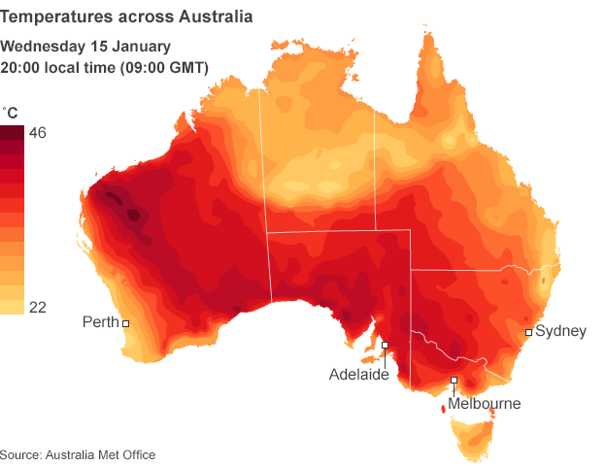
2014

Slide 15
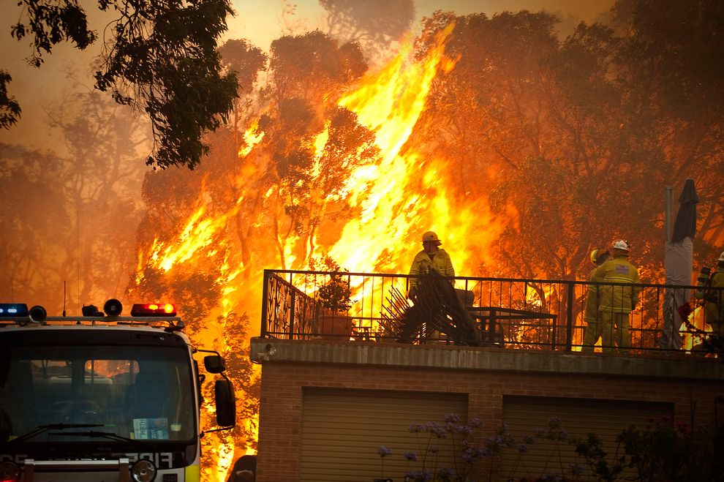
PERTH 2011

Slide 16
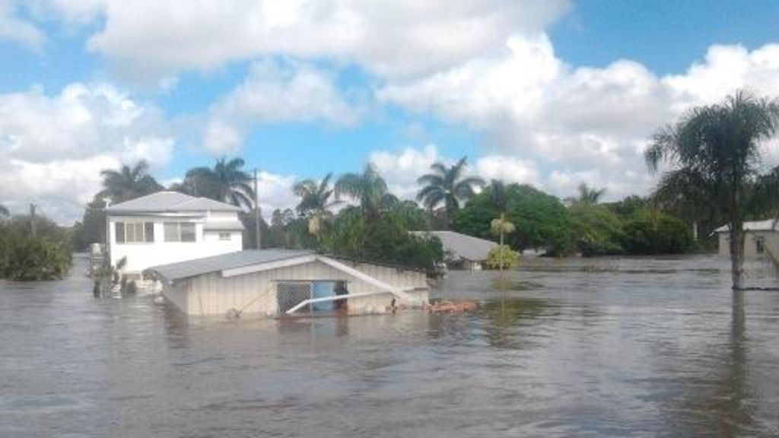
QUEENSLAND FLOODS, JANUARY 2013

Slide 17
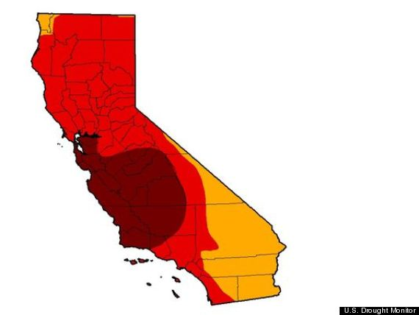
California Drought
Monitor, May 2014

Slide 18
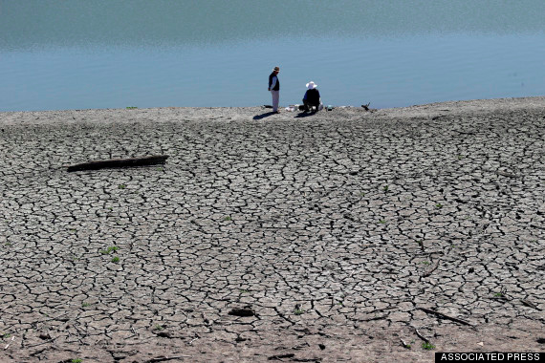
STEVENS CREEK RESERVOIR, MAY 2014

Slide 19
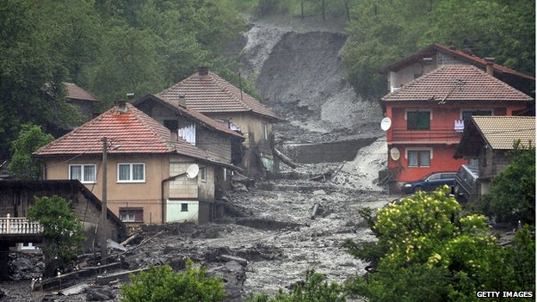
BOSNIA, May 16 2014

Slide 20
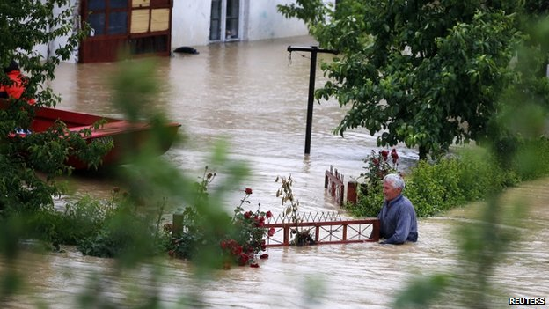
BELGRADE, SERBIA, MAY 16 2014

Slide 21
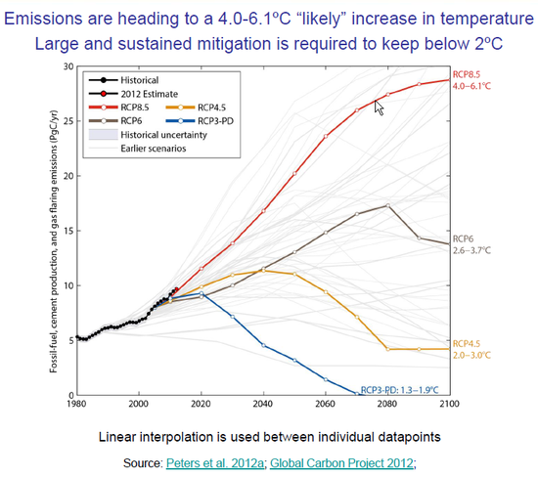
BAU:
4-6 degree C
2-degree C

Slide 22
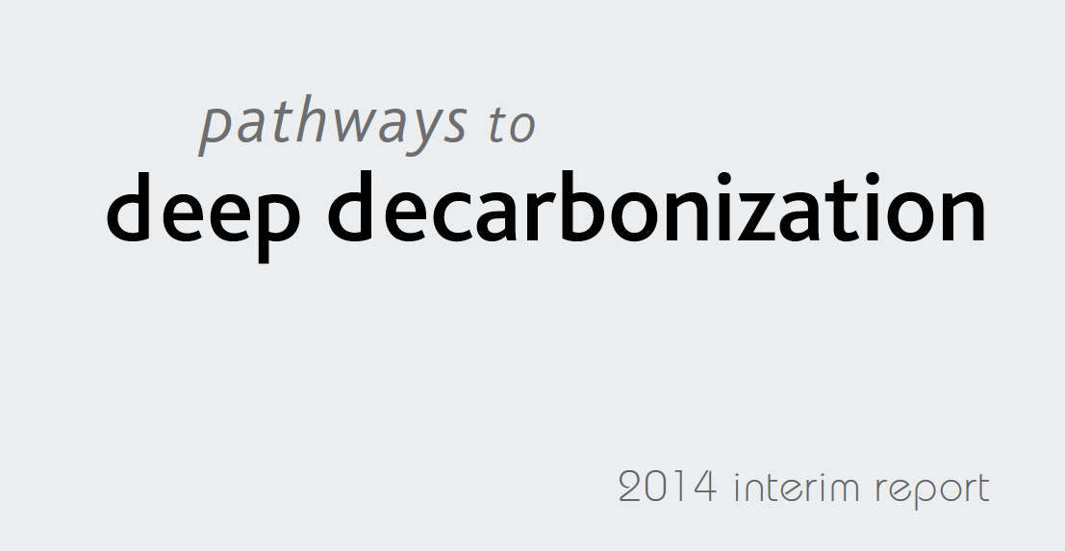
PRACTICAL SOLUTIONS TO ENERGY TRANSFORMATION
AT WWW.UNSDSN.ORG

Slide 23
SOME KEY ELEMENTS FOR 2015:
SDGs: 10 Headline Goals
Means of Implementation:
ODA, Climate Financing, Technology RDD&D, Financial Sector Reform
2-Degree C Climate Agreement
Annual High-Quality Data Cycle
Annual High-Level Political Review

